Slide 1
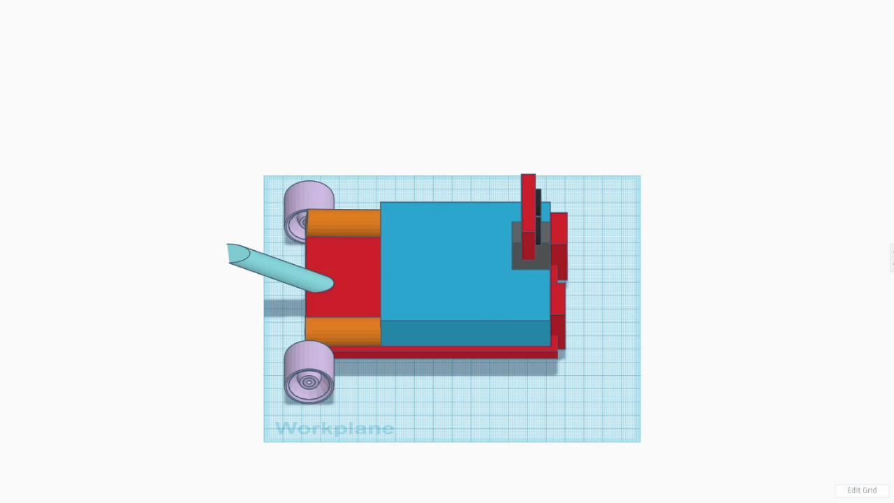

Slide 2
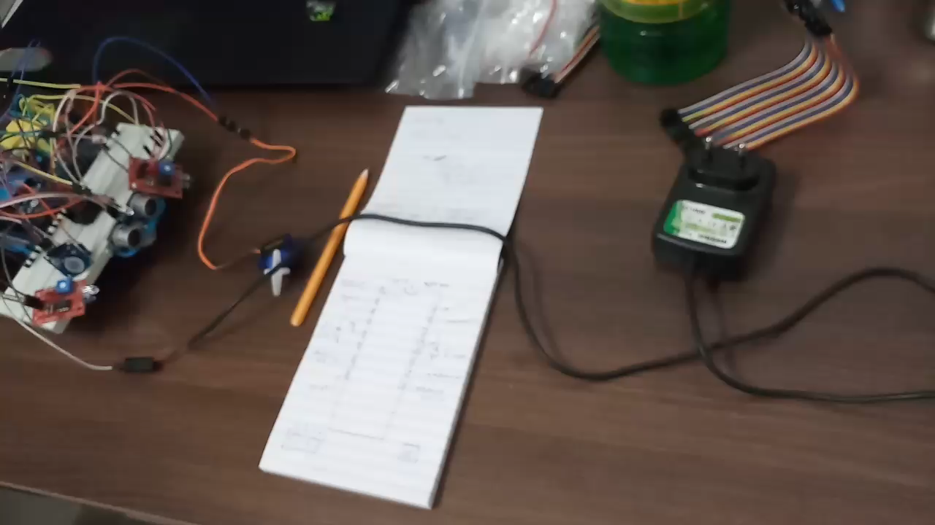

Slide 3
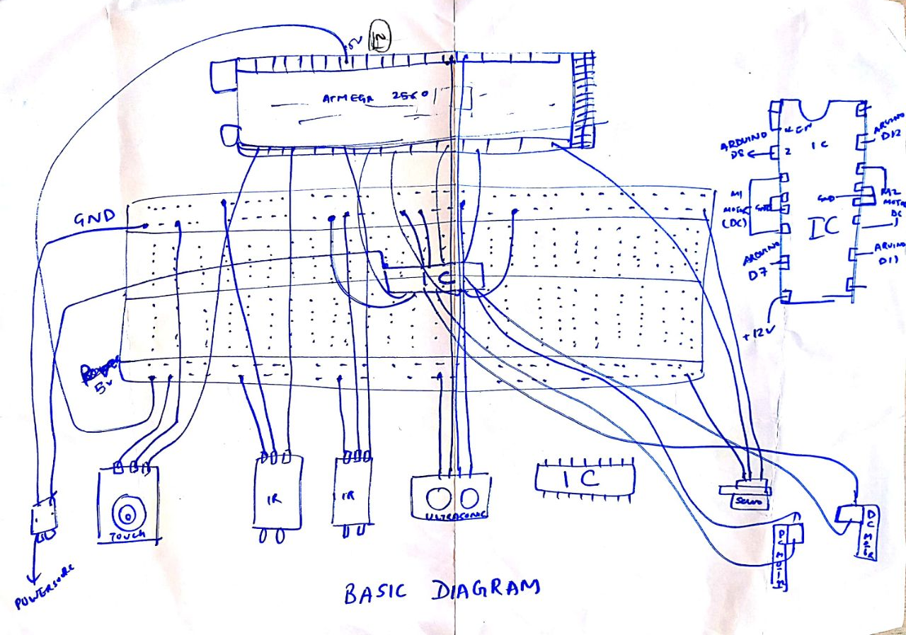

Slide 4
Bill Of Materials:
MATERIAL | COST (₹)
Breadboard | 70
Arduino Mega(2560) | 850
DC Motor 190 (12 V)+Castor Wheel +Chassis | 350
Jumper Wires | 250
Servo Motor | 142
Ultrasonic Sensor | 148
MATERIAL | COST (₹)
Touch Sensor | 175
IR Sensor | 168
LED | 20
Cardboard Extensions | 30
DC Adapter | 250
9V Batteries + Battery Caps | 80

Slide 5
TASK | START DATE | END DATE | DURATION
Team Creation | 01-Feb | 05-Feb | 4
Topic Selection | 06-Feb | 09-Feb | 3
Milestone 1 | 25-Mar | 02-Apr | 8
Gather Requirements | 01-Apr | 05-Apr | 4
UI Design | 05-Mar | 01-Apr | 25
Coding | 01-Apr | 20-Apr | 20
Unit Tests | 13-Apr | 15-Apr | 2
System Test | 16-Apr | 20-Apr | 4
Beta 1 | 21-Apr | 23-Apr | 2
Bug Fixes | 25-Apr | 26-Apr | 1
Improvements | 27-Apr | 30-Apr | 3
Final Testing | 01-May | 05-May | 4
Release Version | 06-May | 10-May | 4

Slide 6
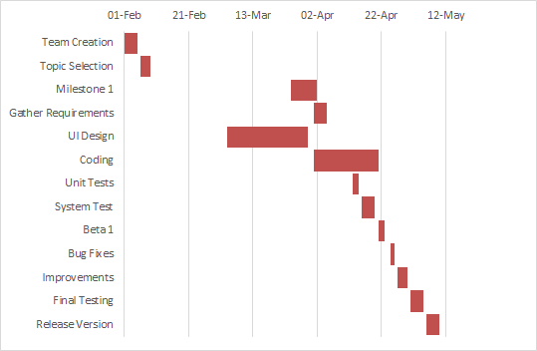
Chart:

Slide 7
THANK YOU

